Slide 1




Employee Data

Slide 2
Pivot tables

Slide 3
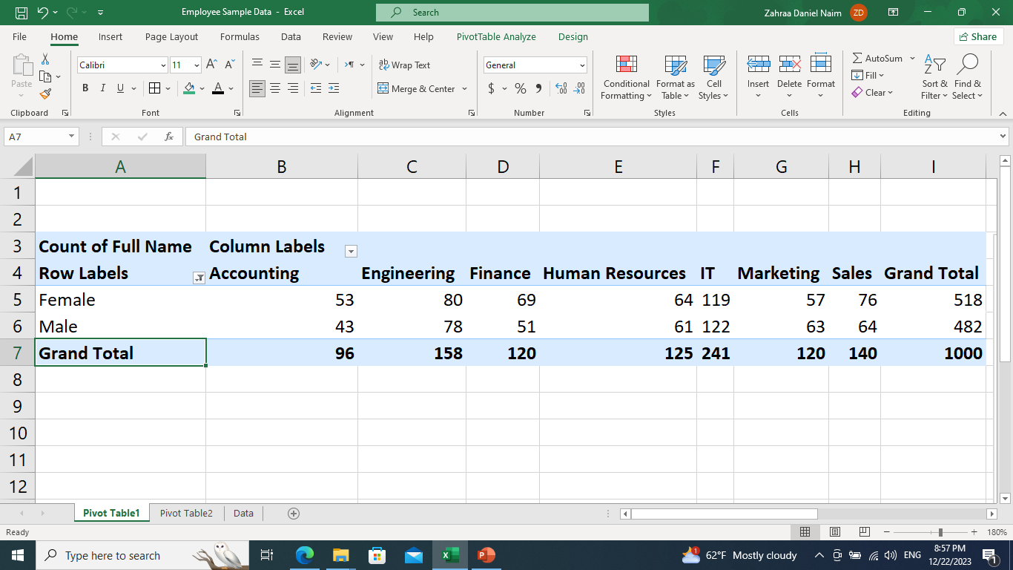
The distribution of employees across different departments.
2. The gender distribution within each department

Slide 4
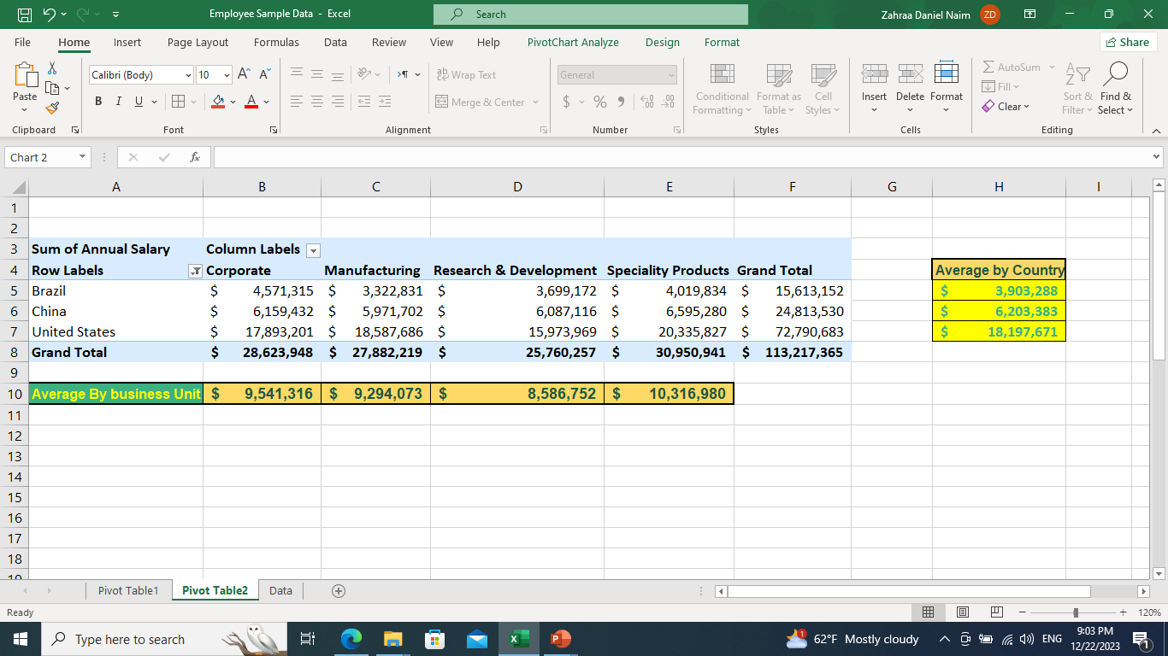
The pivot table in the image represents the sum of annual salaries across different business units (Corporate, Manufacturing, Research & Development, Specialty Products) and countries (Brazil, China, United States). The United States has the highest total salary, especially in Research & Development. The average salary by business unit is highest in Specialty Products, while Brazil has the lowest average salary by country. The table provides a comprehensive view of the distribution of salaries in different business units across various countries.

Slide 5
Visualizations

Slide 6
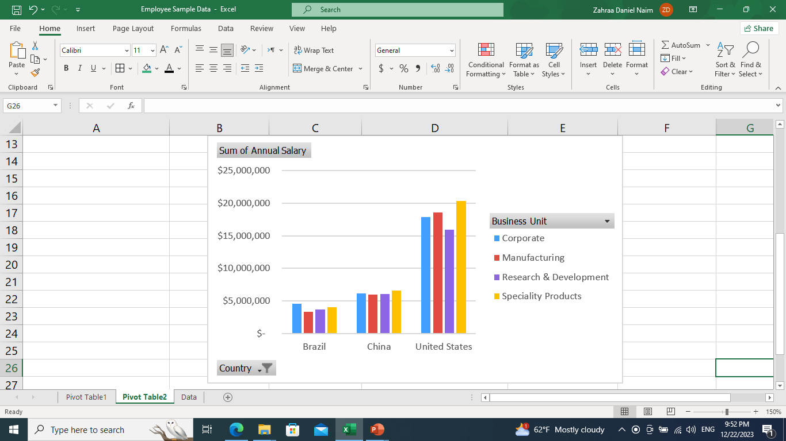
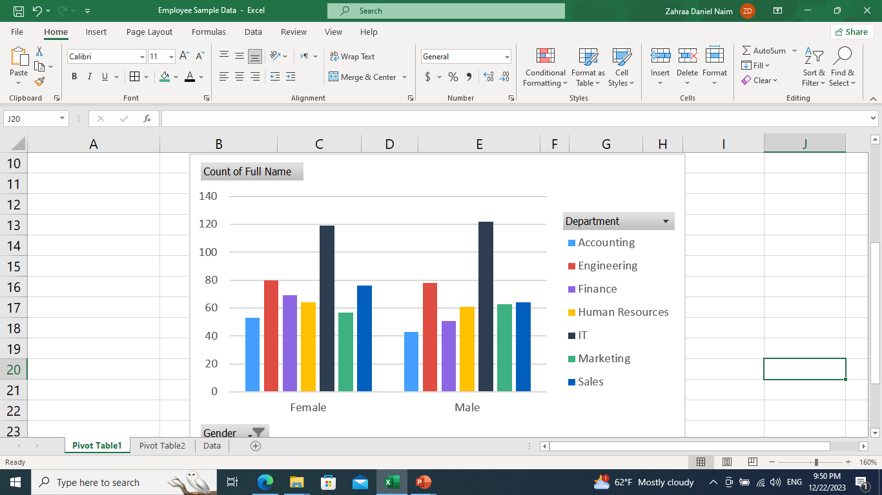

Slide 7
Functions

Slide 8
MAX()
COUNTIF()
VLOOKUP()

Slide 9
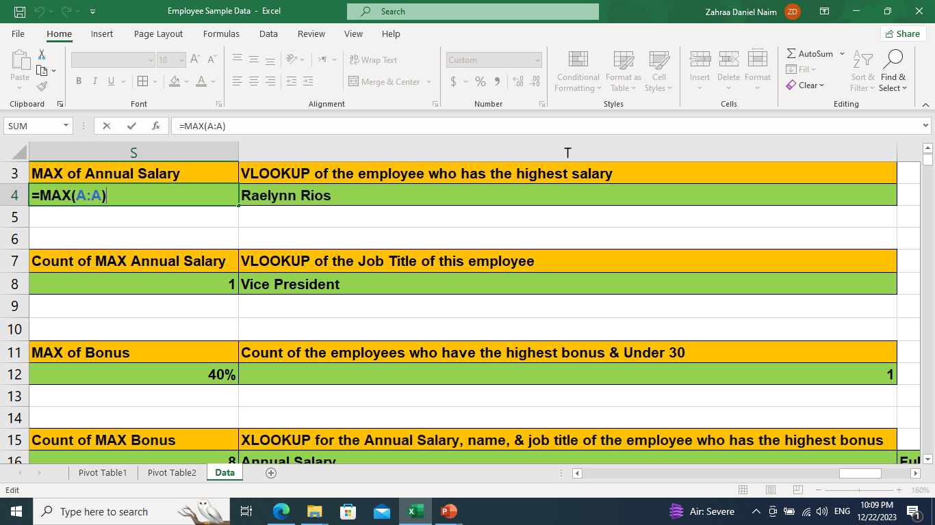
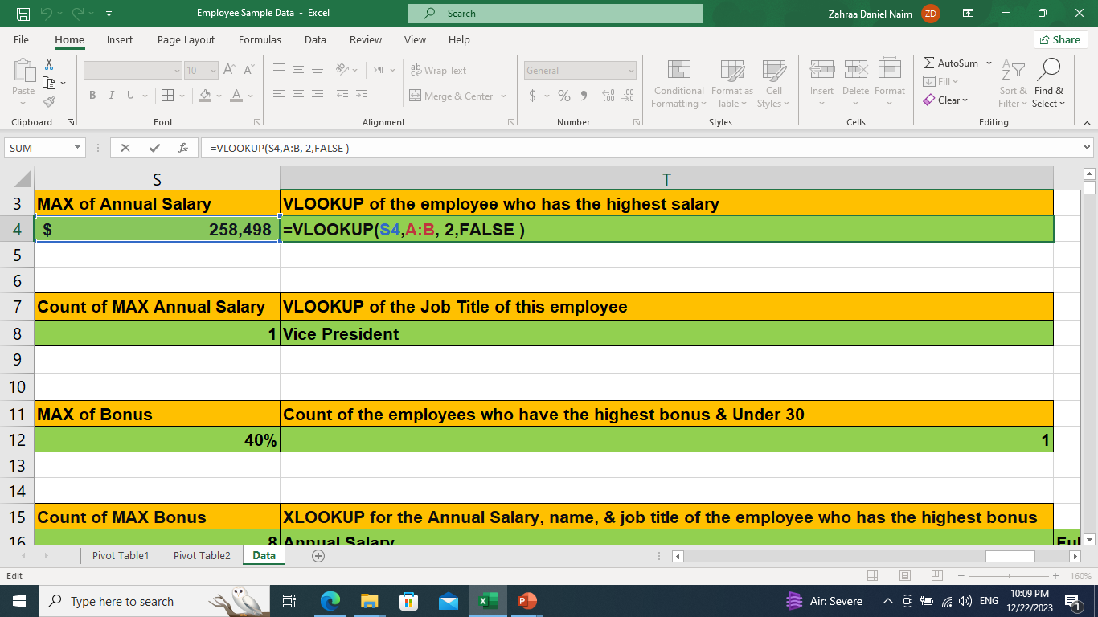
In these two screenshots, I have used the MAX() and VLOOKUP() functions to determine the highest salary given in our company and to whom it is referred.

Slide 10
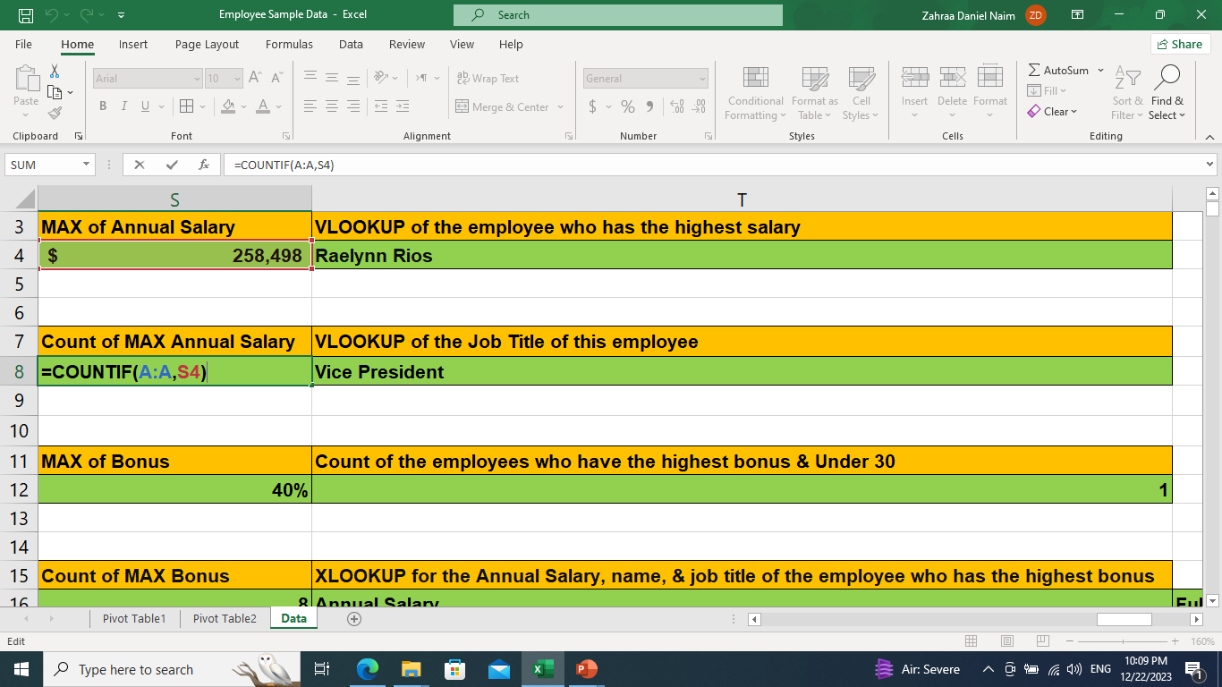
I wanted to ensure that this highest salary is given to only one employee, not many. Since the VLOOKUP function returns only a single value, its usage in this case is correct. We have one value for the highest salary, which was identified through the COUNTIF function that includes the MAX() function, as shown in the photo.

Slide 11
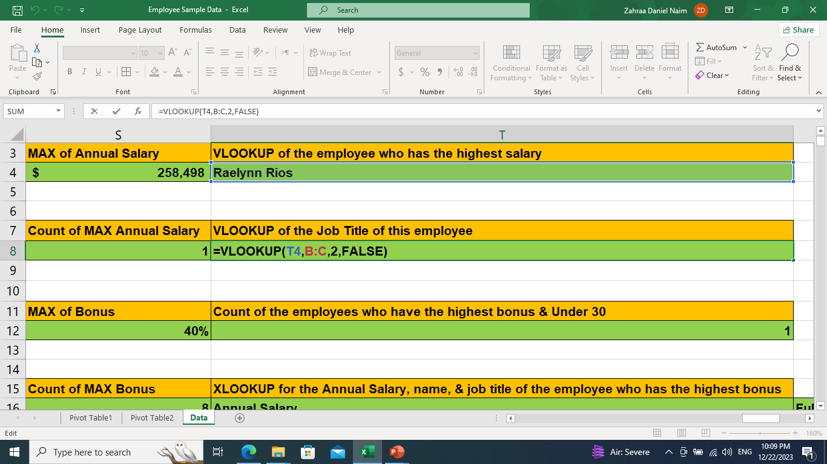
I used another VLOOKUP for the job title

Slide 12
COUNTIFS()
XLOOKUP()
MAX()
COUNTIF()

Slide 13
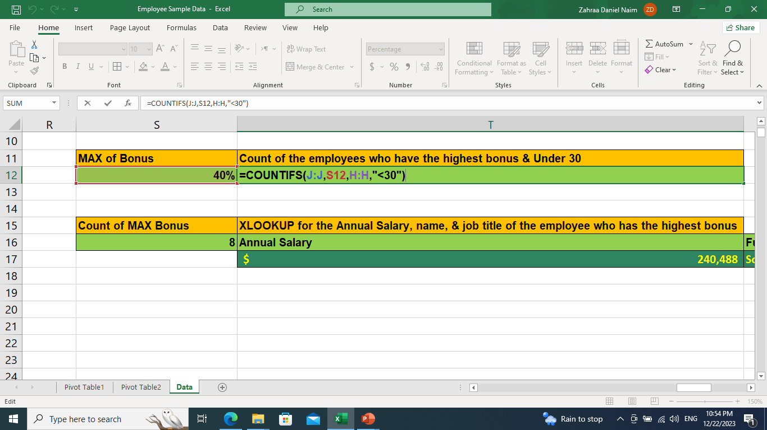
I used the COUNTIFS function to identify the employees who meet the criteria of having the highest bonus and being under 30 years old. The function returned a value of 1, indicating that there is only one employee who meets these criteria.

Slide 14
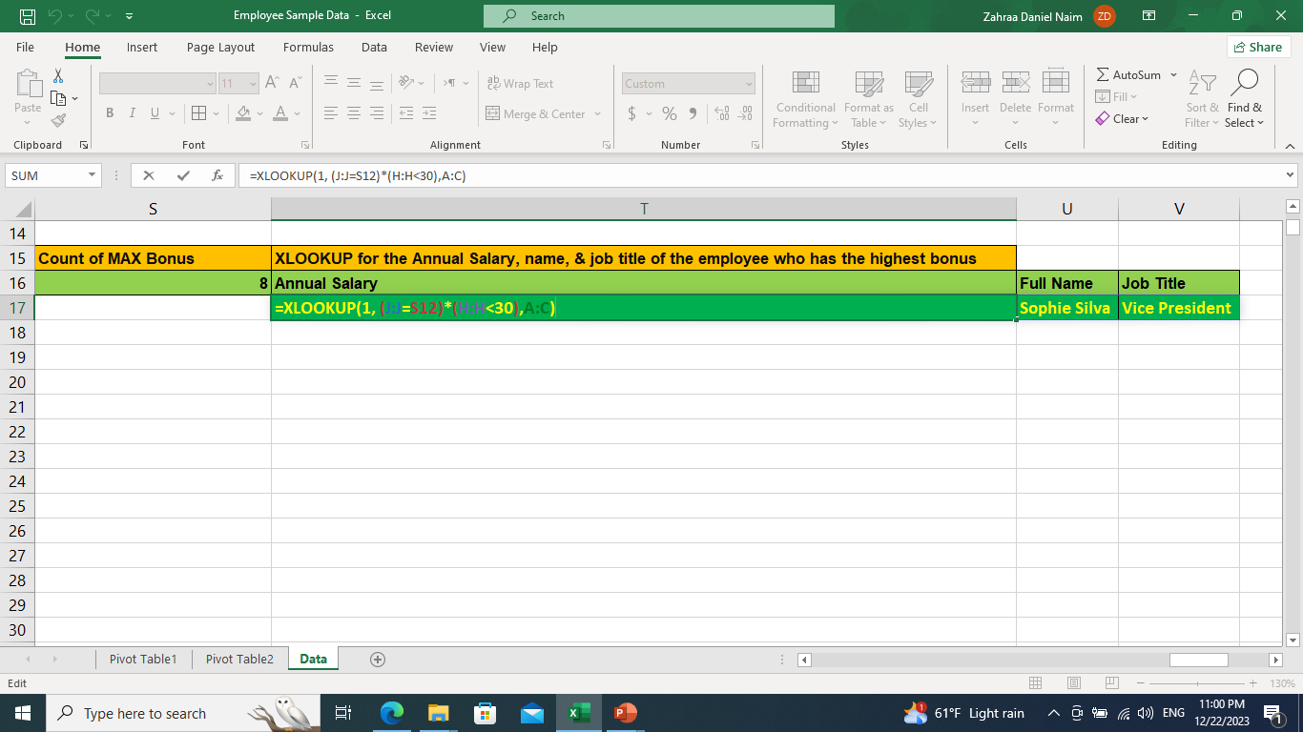
I used the XLOOKUP function to find the salary, name, and job title of the employee who meets the criteria of having the highest bonus and being under 30 years old. As we confirmed earlier, there is only one employee who meets these criteria.

Slide 15
FILTER()

Slide 16
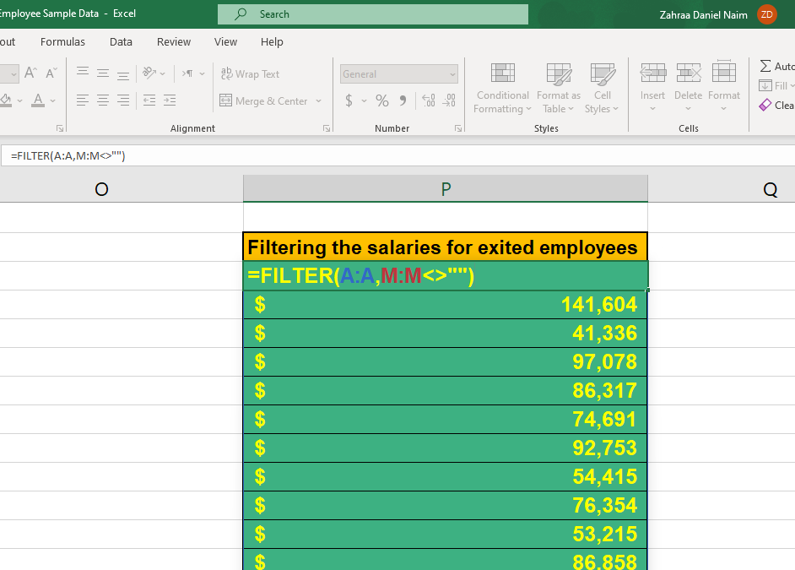
I have used FILTER(salary Column, Exit Date Column<>””), to get all salaries of exited employees

Slide 17
SUM()
AVERAGE()

Slide 18
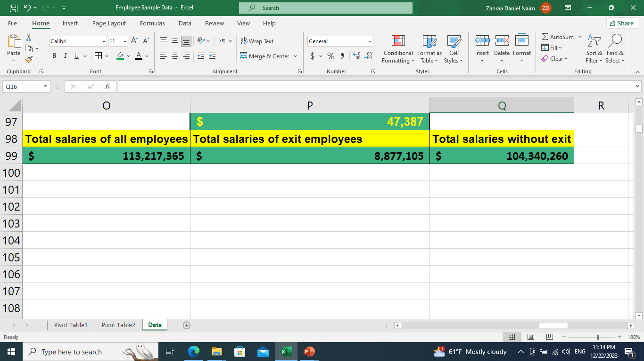
I used the SUM() function to calculate the total salaries of all employees, the exited ones, and the remaining ones by subtracting the latter from the former

Slide 19
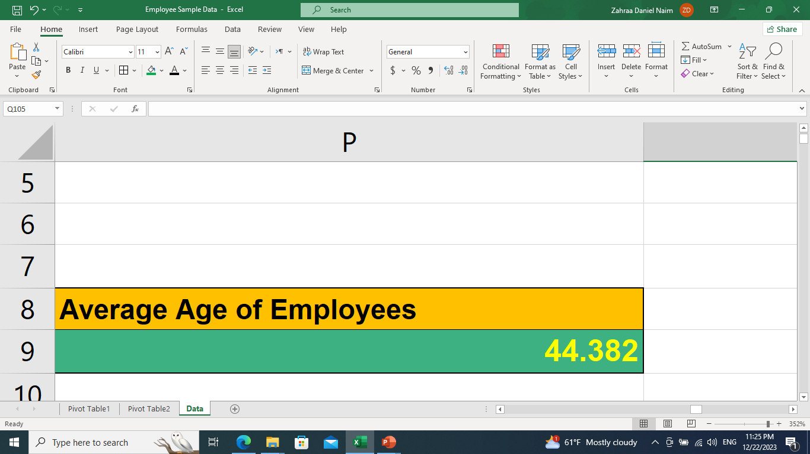
The average employee age of 44.38 years suggests a mature and stable workforce with substantial experience. This necessitates succession planning for those nearing retirement, upskilling for technological advancements, and tailored healthcare benefits.

Slide 20

MORE PROJECTS ARE WAITING
GOOD BYE

